Slide 1

Database Management Systems 19CS2108

Slide 2
Session Outcomes
Recognize the role of diverse users of database and Database environment
Understand the basic terminologies and definitions involved in building Architecture of Database Systems.
Elaborate three Schema Architecture and Data Independence

Slide 3
Topics to be covered
Roles of database users
The Database System Environment
Data Abstraction
Data Models, Schemas and instances
Three Schema Architecture and Data Independence
Database language and interfaces

Slide 4
Database Users
Users may be divided into
Those who actually use and control the database content, and those who design, develop and maintain database applications (called “Actors on the Scene”)
Those who design and develop the DBMS software and related tools, and the computer systems operators (called “Workers Behind the Scene”)

Slide 5
Database Users
Actors on the scene
1. Database Designers:
Responsible to define the content, the structure, the constraints, and functions or transactions against the database.
They must communicate with the end-users and understand their needs.
2. Database administrators:
Responsible for authorizing access to the database, for coordinating and monitoring its use, acquiring software and hardware resources, controlling its use and monitoring efficiency of operations.

Slide 6
Database Users
Actors on the scene
Database administrator's duties include:
Schema definition
Storage structure and access method definition
Schema and physical organization modification
Granting user authority to access the database
Specifying integrity constraints
Acting as liaison with users
Monitoring performance and responding to changes in requirements

Slide 7
Database Users
Actors on the scene (continued)
3. End-users: They use the data for queries, reports and some of them update the database content.
End-users can be categorized into:
a. Casual: access database occasionally when needed
b. Naïve or Parametric: they make up a large section of the end-user population.
They use previously well-defined functions in the form of “canned transactions” against the database.
Examples are bank-tellers or reservation clerks who do this activity for an entire shift of operations
Notes:
Canned transactions are standard types of queries and updates which are frequently used by Naive end users to constantly querying and updating database. These are the transactions that are carefully programmed and tested in advance.

Slide 8
Database Users
End-users
3c. Sophisticated:
These include business analysts, scientists, engineers, others thoroughly familiar with the system capabilities.
Many use tools in the form of software packages that work closely with the stored database.
3d. Stand-alone:
Mostly maintain personal databases using ready-to-use packaged applications.
An example is a tax program user that creates its own internal database.
Another example is a user that maintains an address book

Slide 9
Database Users
4. System Analysts and Application Programmers (Software Engineers)
System analysts determine the requirements of end users, especially naive and parametric end users, and develop specifications for standard canned transactions that meet these requirements.
Application programmers implement these specifications as programs; then they test, debug, document, and maintain these canned transactions. Such analysts and programmers—commonly referred to as software developers or software engineers—should be familiar with the full range of capabilities provided by the DBMS to accomplish their tasks.

Slide 10
Database System Environment
Five elements
Hardware
Software
People
Procedure
Data

Slide 11
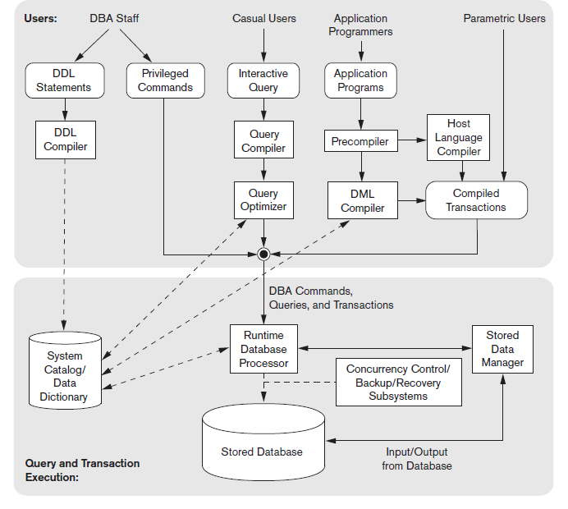
Database system environment

Slide 12
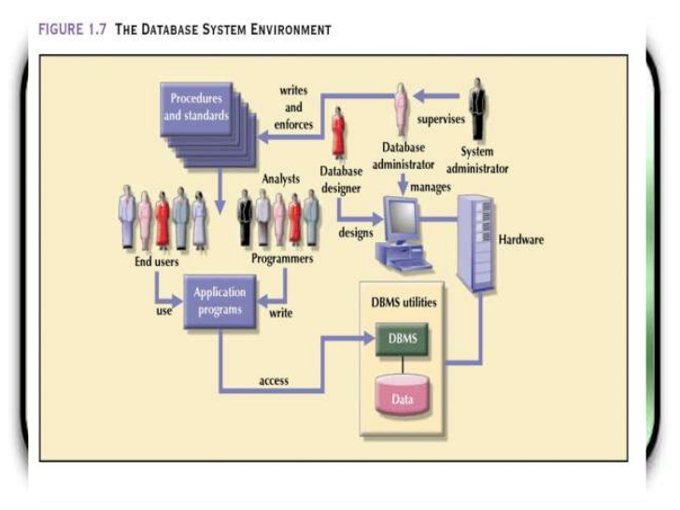

Slide 13
Database System Environment

Slide 14
Data Abstraction
Data Abstraction generally refers to the suppression of details of data organization and storage and highlighting the essential features for improved understanding of data.
Data Models provide the necessary means to achieve data abstraction.

Slide 15

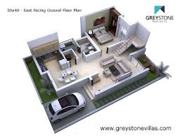
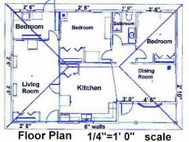
Low
High level view of house
Building Architecture
Quantity of cement, brick, mud, iron, wood….etc to be used.
Middle level view
Civil Engineer
Low level view
Building Constructor
Notes:
What is model

Slide 16
Data Models
Data Model:
A set of concepts to describe the structure of a database, the operations for manipulating these structures, and certain constraints that the database should obey.
Data Models provides the necessary means to achieve data abstraction.

Slide 17
Categories of Data Models
Conceptual (high-level, semantic) data models:
Provide concepts that are close to the way many users perceive data. (WHAT the system contains)
Also called entity-based or object-based data models.
useful to understand the needs or requirements of the database.
Implementation (representational) data models:
Provide concepts that fall in between high and low level, used by many commercial DBMS implementations
e.g. relational data models, hierarchal or network models
represent only the logical part of the database
focuses on the design part of the database.
Physical (low-level, internal) data models:
Provide concepts that describe details of how data is stored in the computer. These are usually specified in an ad-hoc manner through DBMS design and administration manuals

Slide 18
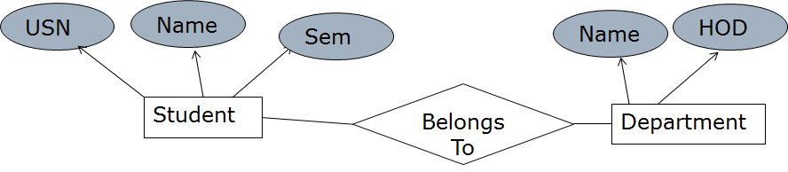
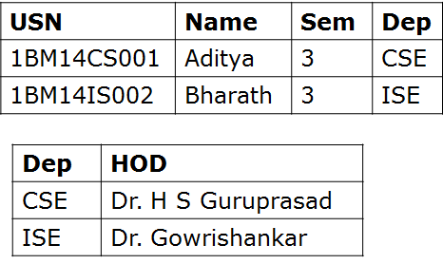
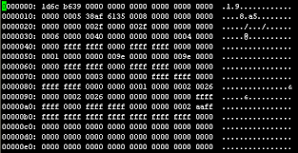
Categories of Data Models
Conceptual (high-level)
Implementation (Representational)
Physical (low-level)

Slide 19
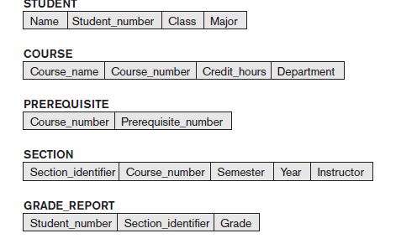
Schemas, Instance and Database State
In a data model, it is important to distinguish between the description of the database and the database itself.
Database Schema:
The description of a database.
Includes descriptions of the database structure, data types, and the constraints on the database.
Scheme Diagram
An illustrative display of (most aspects of) a database schema
Database State:
The actual data stored in a database at a particular moment in time. This includes the collection of all the data in the database.
Also called database instance (or occurrence or snapshot).
The term instance is also applied to individual database components, e.g. record instance, table instance, entity instance

Slide 20
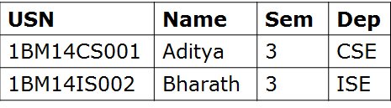
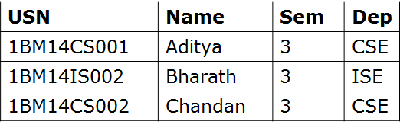
Schemas, Instance and Database State
Schema Diagram
Student
USN | Name | Sem | Dep
Department
Dep | HOD
Database State at time “X”
Database State at time “Y”
Database Instance
Database Instance

